Slide 1


Insights of the Analysis

Slide 2


Today's agenda
Project recap
Problem
The Analytics team
Process
Insights
Summary

Slide 3

Project Recap
Social Buzz is a fast growing technology unicorn that need to adapt quickly to its global scale
Accenture has begun a 3 months POC focusing on the following tasks :
An audit of Social Buzz’s big data practice
Recommendations for a successful IPO
Analysis to find Social Buzz’s top 5 most popular categories of content

Slide 4


Problem
Over 100k posts per day
35 500 000 pieces of content per year
The problem is ? How to capitalize on it when there is so much ?

Slide 5



Karima Benzahra
Data Analyst
The Analytics team
Marcus Rompton
Senior Principle
Andrew Fleming
Chief Technical Architect

Slide 6
Process
1
Data Understanding
2
Data Cleaning
3
Data Modeling
Data Analysis
4
5
Uncover Insights

Slide 7
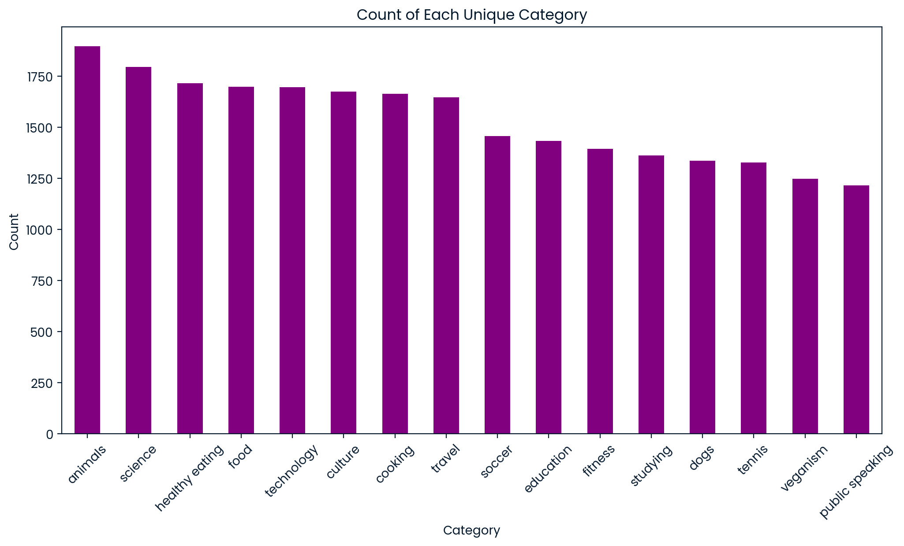

Insights
The dataset contains 16 unique categories

Slide 8
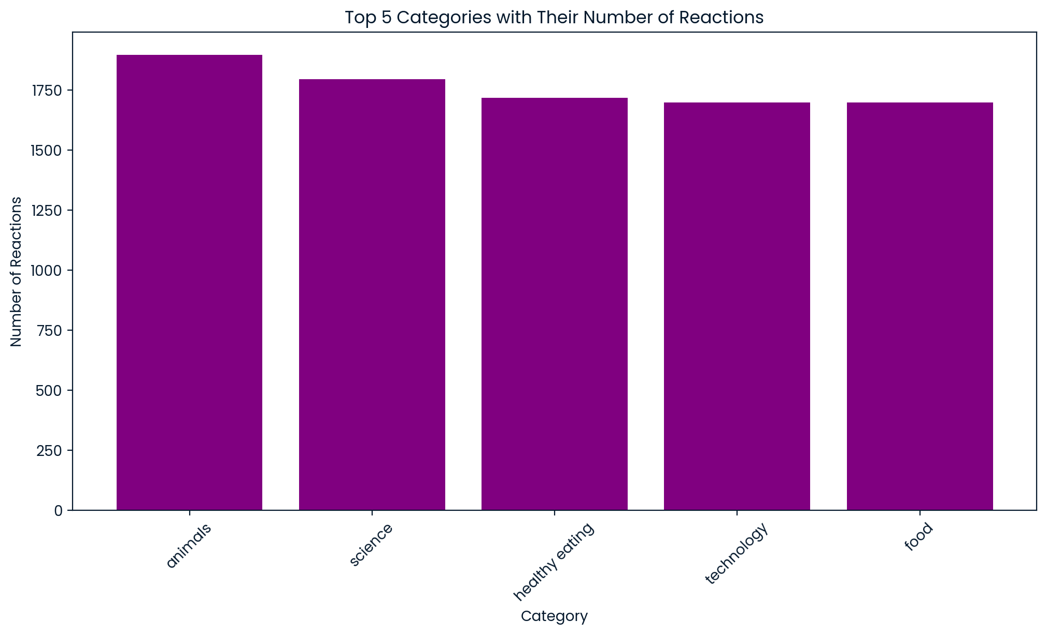
The most popular category “animals” has an exact number of reaction : 1897

Slide 9
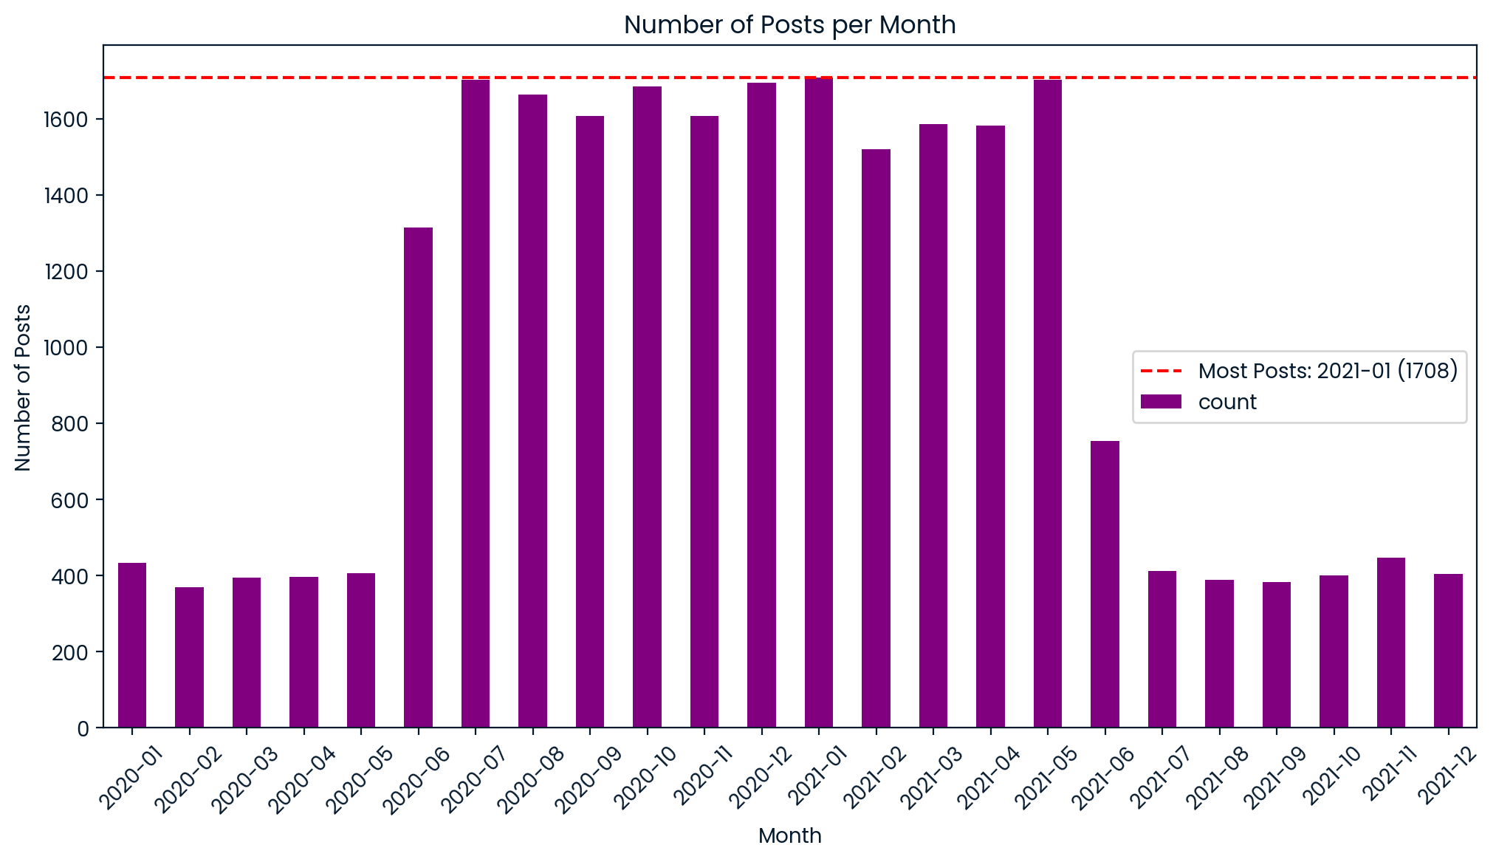
the month with the most posts is January 2021 with number of posts = 1708

Slide 10

In summary, our analysis highlights the top 5 content categories by reaction count, showcasing the most engaging topics for your audience. Additionally, we identified monthly posting trends, with a clear peak in activity, which can inform your future content planning and engagement strategies. These insights are crucial for optimizing Social Buzz’s content to better meet audience preferences and maximize engagement.
Summary

Slide 11

Thank you!
ANY QUESTIONS?

